Slide 1






Department of Computer Science and Engineering
(ArtificialIntelligenceandMachineLearning)
AI-Based Electrical Fire Prevention System Using IOT Sensors and Machine Learning
Guide Name:
Team Members
Dr. G Revathy Assistant Professor Department of AI&ML
Surabhi Kerketta Vagitha Rifana Rithika G

Slide 2




Introduction
Electrical fires are one of the leading causes of property damage and loss of life,often resulting from unnoticed electrical faults.Traditional fire alarm systems are mainly reactive,as they detect smoke or flames only after a fire has already started. This project aims to shift from reactive fire detection to proactive fire prevention by using real-time sensor data and Machine Learning to predict potential fire risks before ignition occurs. An ESP32-based IoT system continuously monitors important electrical and environmental parameters such as temperature,voltage,current,and smoke to identify abnormal conditions.Based on the collected data,the system automatically classifies the level of fire risk and takes preventive actions,including power disconnection,buzzer activation,and SMS alerts,thereby improving electrical safety and enabling early intervention.

Slide 3




ABSTRACT
Electrical fires are one of the leading causes of property damage and are often detected only after smoke or flames appear.This project proposes an AI-Based Electrical Fire Prevention System that predicts fire hazards before ignition using IoT sensor and Machine Learning.The system continuously monitors temperature, voltage, current, and smoke levels through an ESP32 microcontroller.A machine learning model analyzes the combined sensor data and classifies the fire risk into Safe, Warning, High Risk, and Critical levels.During critical conditions,the system automatically disconnects the power using a relay,activates a buzzer,sends an SMS alert through the SIM800L GSM module,and stores the event for future analysis.This low-cost,real-time solution improves electrical safety in homes,offices,laboratories,and industrial environments by preventing fires before they occur.

Slide 4

Literature Survey
AUTHOR
NAME
FEATURES
METHODOLOGY
DATASET
ADDRESS
LIMITATIONS
3,478 samples collected experimentally. 3,025 normal (N) and 453 pre- ignition (51) samples. Features: temp., humidity, CO, CO₂, voltage, current, cable temp., outdoor temp. and humidity
Binary normal vs. pre- ignition classification due to limited S2-S4 samples. Dataset specific to the experimental panel; needs more diverse real-world electrical-fire data
Temperature, humidity, CO, CO₂, voltage, current, cable temperature, outdoor temperature & humidity; IoT sensors; ML-based anomaly detection; pre-ignition prediction
Arduino Mega + Raspberry Pi 4; DHT22, MQ135, MQ4, PZEM- 004T, MLX90640 sensors. ML models: DT, GNB, GPC, SVM with 5-fold cross-validation and RFE feature selection
Predicts electrical panel anomalies and early fire. risk for predictive maintenance using IoT and ML. GPC model achieved the best performance
Muhammed Fatih Peksen, Ulaş Yurtsever, Yılmaz Uyaroğlu (2024)
Electrical parameter monitoring; arc detection; smart circuit breakers; EC-IoT cloud–edge– terminal architecture; BIM/digital building simulation; early-fire warning
EC-IoT cloud-edge-terminal architecture: Modbus edoe response model; electrical sensors, arc detection, smart circuit breakers: BIM/digital building simulation
No conventional public ML dataset. Uses electrical monitoring system data and digital building simulation
Provides early warning of electrical fires in high-rise residential. buildings and supports evacuation and fire-rescue decision making.
Focus mainly on electrical parameters; limited multi- source heterogeneous data integration; digital simulation accuracy can affect results
Mengying Ma, Chengdi Xu, Junfeng Han (2025
AI-based fire-fighting supervision; facility monitoring; maintenance monitoring; staff training; questionnaire and field- investigation based evaluation
Mixed methods: questionnaires, interviews, field investigation, field visits, secondary data analysis and comparative case study
91 valid questionnaires from two public-building cases + interviews and field investigation secondary data
Evaluates effectiveness of Al in fire-fighting facility supervision, operation, maintenance and staff training
Small sample size and limited geographical coverage; case-geograph study based; not not nationally n representative
Weijie Xu, S. C. Chan, W. Y. Leong (2023)
WSN; BLE beacons; ESP32/Raspberry Pi; fire-condition sensing; indoor location tracking; AI-based dynamic pathfinding; real-time fire detection and evacuation
WSN, BLE beacons, ESP32/Raspberry Pi, and Al- based dynamic pathfinding for real-time fire detection and evacuation routing
No conventional/public benchmark dataset reported. Uses sensor, fire- condition and indoor location information
Provides real-time indoor fire detection and personalized evacuation routes based on location and changing fire conditions.
Prototype level; limited real-world validation; high processing requirements; privacy and interoperability concerns.
Abhishek Andil, Pranav Bhalerao, Gaurav Raygade, Saurav Bhosale, Pradnya Kasture (2025)

Slide 5


Literature Survey
FEATURES
METHODOLOGY
DATASET
ADDRESS/ CONTRIBUTION
LIMITATIONS/ RESEARCH GAP
AUTHOR NAME
Temperature, gas concentration, smoke density; IoT-enabled sensors; automated alerts; fire suppression; risk classification (High/Low).
Simulated data; needs real- world pilot testing; power, false-positive and affordability issues
Jameson Mbale, Ndanji Simbeye (2025)
Arduino, IoT sensors, threshold logic, cloud alerts, automated suppression
240 simulated observations: temperature, gas, smoke
Low-cost real-time fire prevention and automated response; Zambia context
Wi-Fi + LoRaWAN; MQ2/gas sensor; flame sensor; environmental sensors; long- range communication; fault- tolerant fire monitoring.
Wi-Fi + LoRaWAN, Wi-Fi LoRa 32, gas/flame/environmental sensors
Mainly communication- focused; false alarms and network limitations
Experimental network data; 50 packets, 16–64 bytes, up to 600 m
Fault-tolerant long-range communication for smart- building fire monitoring
Abdullah Safi et al. (2022)
YOLO/YOLOv4, CNN, Fast R- CNN; satellite imagery; FireWatch sensor images; deep-learning-based smoke/fire detection; wildfire monitoring
Aigulim Bayegizova et al. (2024)
Satellite + FireWatch images; Kaggle/image datasets
Fast automated wildfire/fire detection; YOLOv4 reported 98.9% accuracy
Small/short fires difficult in satellite images; FireWatch coverage and cost limitations
YOLOv4, CNN, Fast R-CNN
CNN, YOLO, ResNet, MobileNet; multi-sensor data fusion; IoT; Kalman filtering; Bayesian fusion; knowledge distillation; edge/embedded systems.
CNN, YOLO, ResNet, MobileNet, IoT, multi-sensor fusion
FireNet, BoWFire, FASDD, D- Fire, PYRONEAR, and other publicly available fire/smoke datasets.
Combines multiple sensors and AI to improve robustness and reduce false alarms
High computation; limited standardization and real- world validation
Gwamzhi Ponsah Emmanuel et al. (2025)

Slide 6


Problem Statement
Electrical fires are mainly caused by overheated wiring, voltage surges, and current overloads. Traditional fire alarms detect smoke or heat only after a fire starts. An AI-based real-time system can predict fire risks before ignition and help prevent accidents.

Slide 7







Objective
To design a real-time electrical fire monitoring system using ESP32 with temperature,voltage,current,and smoke sensors.
To develop a Random Forest Machine Learning model that analyzes multi-sensor data to detect abnormal conditions that may lead to electrical fires.
To classify fire risk into four levels: Safe,Warning,High Risk,and Critical.
To automatically disconnect the power supply using a relay and activate a buzzer during critical conditions.
To send SMS alerts using the SIM800L GSM module without requiring Wi-Fi or Internet.
To log all sensor readings,risk levels,and system events for monitoring,analysis,and future model improvement.
To develop a cost-effective,scalable,and reliable electrical fire prevention system for homes,offices,laboratories,and industrial environments.

Slide 8




Methodology
Theproposedsystem continuously collects temperature,voltage, current, and
smoke readings using sensors connected to an ESP32 microcontroller.The collected sensor data is filtered and preprocessed to remove unwanted variations and prepare it for analysis. The preprocessed data is then given to the proposed Random Forest machine learning classifier,which analyses the sensor parameters and predicts the electrical fire risk.The predicted risk is classified into four levels: Safe,Warning,High Risk, and Critical. When a Critical condition is detected,the system automatically disconnects the power supply through a relay, activates a buzzer,and sends an SMS alert using the SIM800L GSM module.Finally,sensor readings, risk levels, and system actions are stored for monitoring, analysis, and future improvement of the model.

Slide 9


System Flow
Sensors
Temprature | Current | Voltage | Smoke
ESP32 Microcontroller
Data acquisition & preprocessing
Random Forest ML Model
Pattern analysis on combining data
Risk classification
Safe | Warning | High Risk | Critical
Event Logging
Critical?
Automated Response
Relay cuts Power Buzzer sounds SMS sent via GSM Module
to registered contact
Continue Monitoring

Slide 10

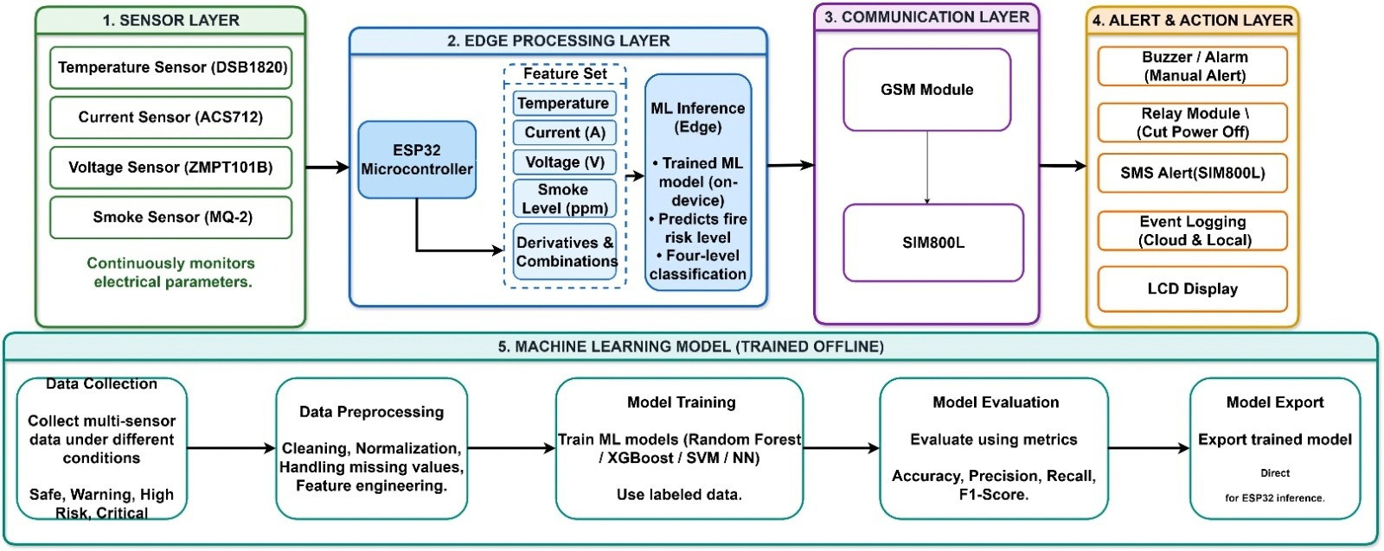
Architecture

Slide 11
Outcome
A
working
prototype
that
utilizes
ESP32
to
monitor
temperature,current,voltage,and smoke in real-time.
Risk levels were classified as Safe,Warning,High Risk,and Critical based on the trained Random Forest ML model and the Decision Tree Model.
The system was able to automatically cut off the power,trigger a buzzer,and send an SMS notification upon detecting a Critical risk level.
The prototype also had a log of all the events that occurred,including sensor reading,risk level,and action taken.
A low-cost and relliable system that showcases the shift from traditional fire alarm systems to AI-enabled fire prevention systems.

Slide 12

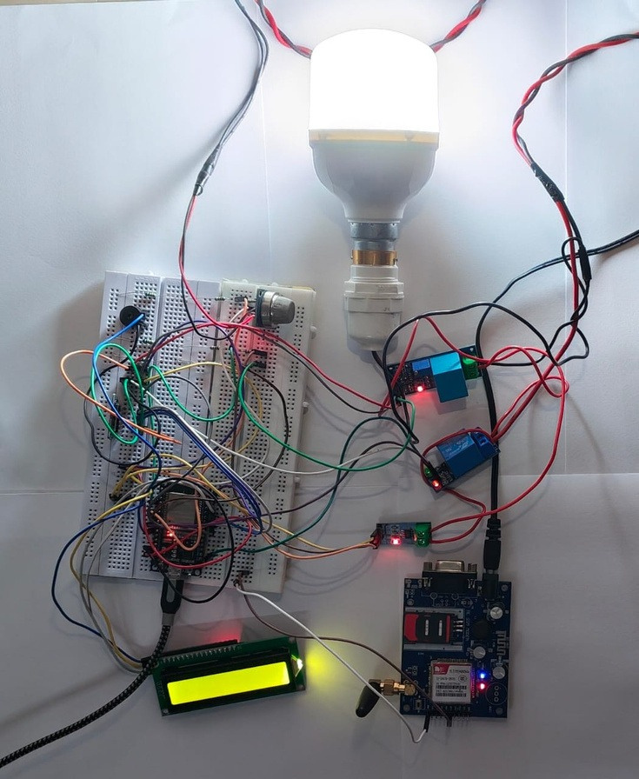
AI-Based Fire Prevention System
1.Power on: The MQ-2smokesensorwarmsupfirst, because its readings
aren't stable until then.
2.Sensing: The ESP32 reads four values: temperature, current, voltage and
smoke.
3.Combining: it puts the four readings together as one input.
4.Classifying: the trained Decision Tree, running on the ESP32 itself, rates the
situation as Safe, Warning, High Risk or Critical.
5.Displaying: the LCD shows the current risk
level
6.Acting on the level:
Safe: it keeps monitoring.
Warning: it sends an SMS alert.
Critical: the relay cuts the power to the load, the buzzer sounds, and an urgent SMS is sent.
7.Alerting: the SIM800L GSM module sends the SMS over the mobile network,
so no Wi-Fi or internet is needed.

Slide 13
References
[1] Mbale, J., & Simbeye, N. (2025).DevelopmentofanIntelligentFirePrevention System Using IoT-Enabled
Sensors and Automated Countermeasures.
[2] Ma, M., Xu, C., & Han, J. (2025). Application of an Intelligent Electrical Fire Monitoring System Based on the EC-IOT Framework in High-Rise Residential Buildings.
[3] Xu, W., Chan, S. C., & Leong, W. Y. (2023). Effectiveness Study of Artificial Intelligent Facility System in Maintaining Building Fire Safety.
[4] Bayegizova, A., et al. (2024). Fire Detection Using Deep Learning Methods. IJECE, 14(1), 547–555.
[5] Khan, M., et al. (2026). ESP32-Based Intelligent Fire Detection System Utilizing Machine Learning and Computer Vision for Enhanced Safety in Indian Micro and Small Enterprises.
[6] Elhanashi, A., et al. (2025). Early Fire and Smoke Detection Using Deep Learning: A Comprehensive Review of Models, Datasets, and Challenges. Applied Sciences, 15, 10255.
[7] Mastanamma, Y., et al. (2026). IoT-Based Multi-Sensor Fire Detection and Automated Suppression System with Electrical Isolation. IJRASET, 14(IV), 2337–2343.
[8] Emmanuel, G. P., et al. (2025). Intelligent Fire Detection Systems Using Deep Learning and Multi- Sensor Data Fusion: A Comprehensive Review. IJSRED, 8(5), 2346–2357.

Slide 14

Gantt Chart
ACTIVITES
WEEK 01
WEEK 02
WEEK 03
WEEK 04
WEEK 05
WEEK 06
WEEK 07
WEEK 08
WEEK 09
WEEK 10
Problem identification & Requirement Analysis
Literature Survey
System Design & Architecture
Component selection & Procurement
Hardware circuit Design
Sensor integration & Data
collection
Data Preprocessing
ML Model Development & Risk Classification
Esp32 - ML Model Integration
Relay, Buzzer & GSM(SIM800L) Integration
Local Data Logging(MicroSD) & LCD Display
Testing & Performance Evaluation
Final Prototype Documentation & Presentation

Slide 15





Conclusion
In conclusion, we developed an AI-powered electrical fire prevention system using ESP32, IoT, and Machine Learning. The system continuously monitors electrical parameters to predict potential hazards at an early stage. During critical conditions, it automatically disconnects the power supply, activates an alarm, and sends SMS notifications. Overall, this system provides a smart, reliable, cost-effective, and scalable solution to improve electrical safety in various environments.

Slide 16


